Slide 1
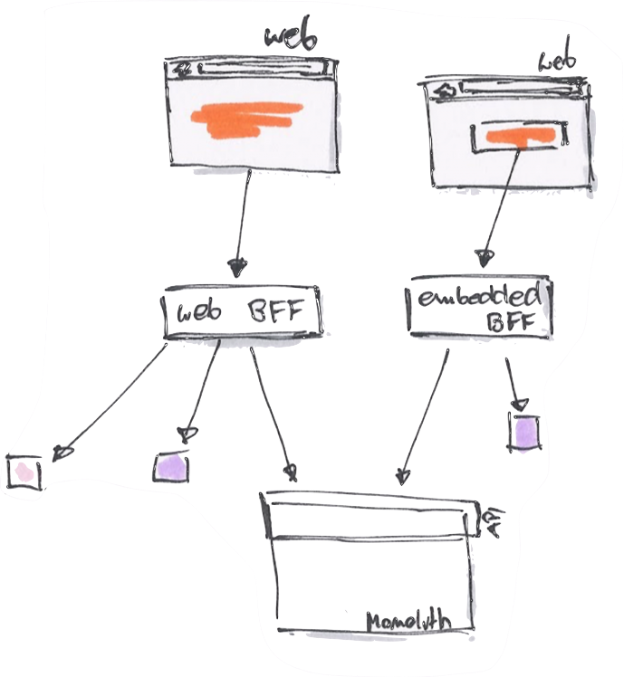
Backends For Frontends
By Luis Atencio (@luijar)

Slide 2


About me...
Cloud Engineer @ Citrix Systems
10+ years architecting web apps using PHP, JavaScript, and Java
Author
Speaker
luisatencio.net

Slide 3
In brief:
PHP7
Functional programming
Reactive programming
Docker
Service orchestration

Slide 6
Around 2000s...
Business Process
Execution Language (BPEL)

Slide 7

Back to the present...
Essential pattern for architectures with a large number of services
Need to aggregate multiple downstream calls to deliver user functionality
Single Backend-for-Frontend can result in multiple calls to microservices

Slide 8
A Backend-for-Frontend (BFF) is a pattern for designing
API backends to aggregate multiple (scattered)
downstream services

Slide 9
What is the “right” pattern for this?

Slide 10
Meet your BFF
Reactive Extensions for PHP (RxPHP)

Slide 11
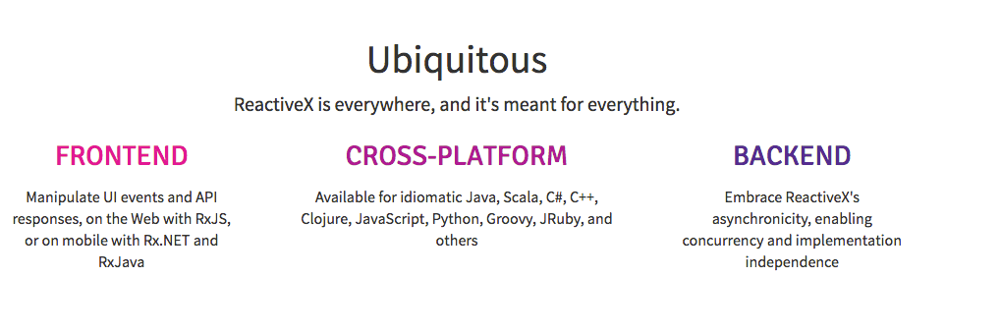

Slide 12
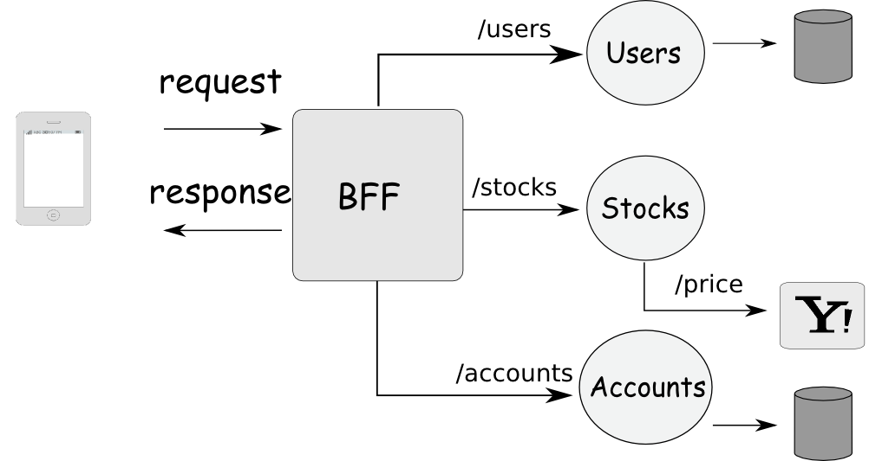

Slide 13
RxPHP is a functional library to compose asynchronous
and event-based programs using observable collections
and LINQ-style query operators in PHP.
- https://github.com/ReactiveX/RxPHP

Slide 16
Observables are functional
Immutable
Lazily evaluated
Handle 1 or infinitely many values
Pure
Declarative
Monadic

Slide 17
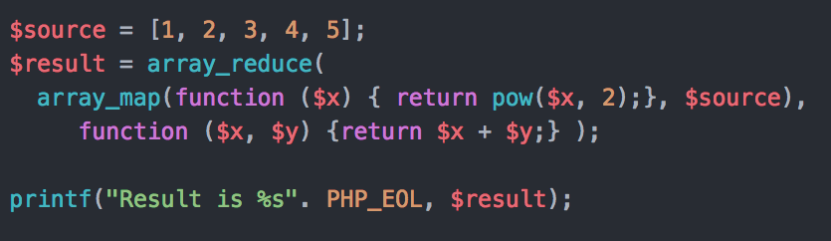

Slide 18
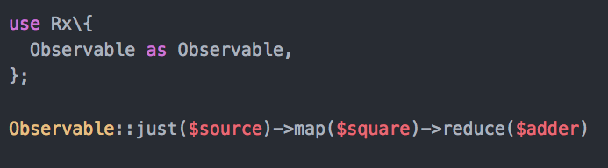

Slide 19
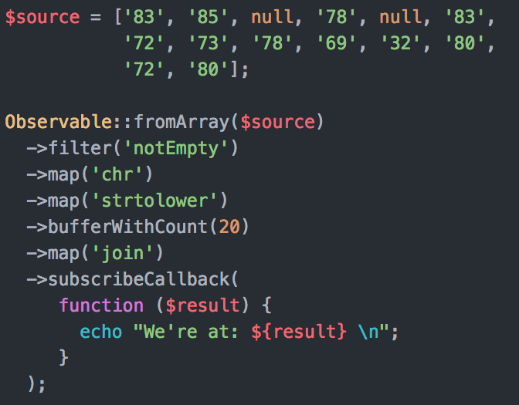

Slide 20
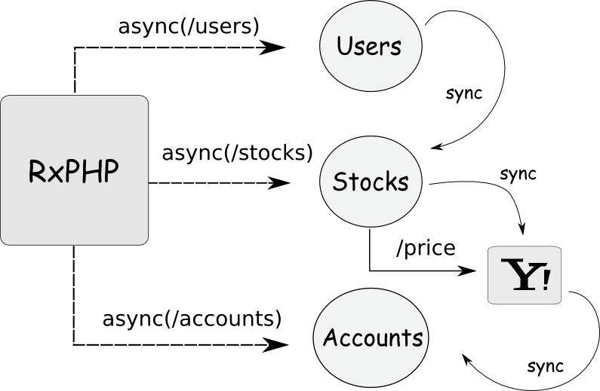

Slide 21
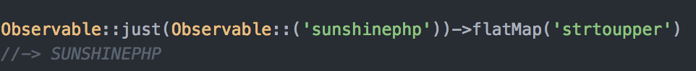
Observables are monadic
Unit function: just(), from(), of(), ...
Mapping: map()
Bind operator: flatMap(), mergeMap(), bind(), ...

Slide 22
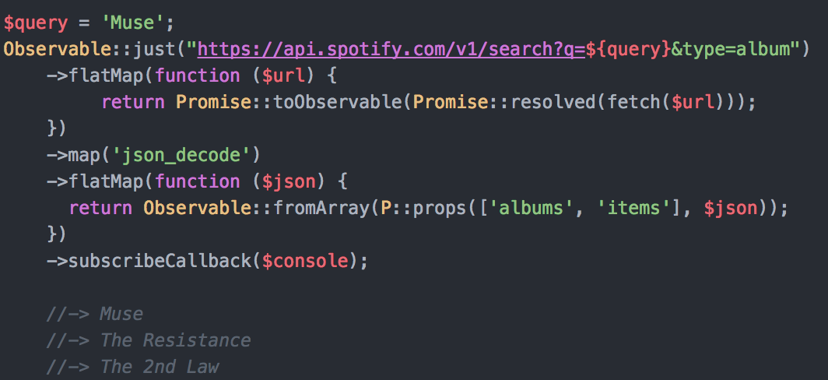

Slide 24
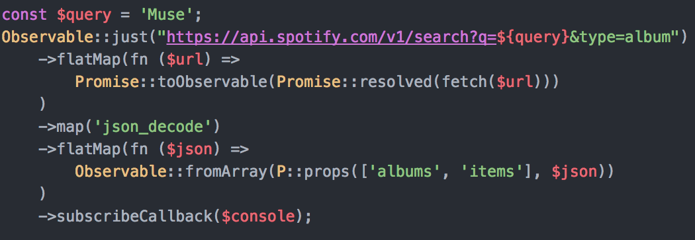
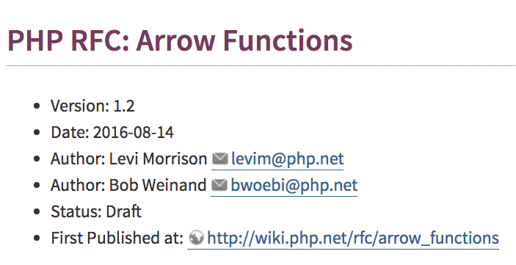
Later 2017?

Slide 25
DEMO

Slide 26
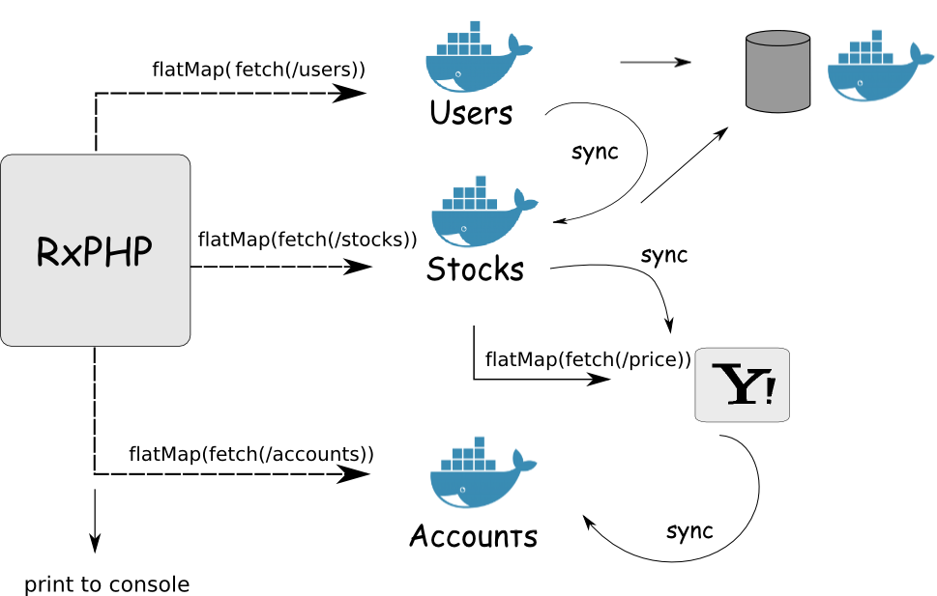

Slide 27
docker-compose
+

Slide 28

To reduce()...
RxPHP is your BFF (Backend for Frontend)

Slide 29

Resources
Functional Programming in JavaScript
G: fp js manning
discount: 39atencio
RxJS in Action
G: rxjs manning
discount: 39daniels
Functional PHP
G: fp php leanpub
Free!
Functional PHP 7 Video Course
G: functional php7 packt

Slide 30
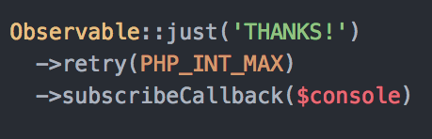
@luijar

